Slide 1

Oracle 11g: SQL
Chapter 1 Part C
Normalization

Slide 2
Objectives
Determine dependencies and how they can lead to redundant data and anomalies
Address dependencies and anomalies through the process of Normalization and Normal Form (NF)
Oracle 11g: SQL

Slide 3
6 Properties of Relations
NOT ALL 2D TABLES ARE RELATIONS!
1
2
3
4
5
6
Notes:
Not all 2D tables are relations
Each relation has unique name
Values in each cell are atomic (single-valued) – no multi-valued attributes
Each row is unique (no two rows are identical)
Each column within a table has unique name
Sequence of columns is insignificant (can be interchanged without changing the meaning)
Sequence of rows is insignificant (can be interchanged or stored in any sequence)

Slide 4
Dependencies
Total or full dependency
Partial dependency
Transitive dependency
Notes:
Total or full dependency = A nonkey column dependent on all primary key columns
Partial dependency = A nonkey column is dependent on only part of the primary key
Transitive dependency = A nonkey column is dependent on another nonkey column
INVOICE table
ItemName and ItemPrice are nonkey columns that are dependent only on a part of the primary key column ItemNo. They are not dependent on the InvNo column.
InvDate is dependent only on InvNo.
The nonkey column CustName is not dependent on any primary key column but is dependent on another nonkey column, CustNo. It is said to have transitive dependency.
The nonkey column Qty is dependent on both InvNo and ItemNo, so it is said to have full dependency

Slide 5
Dependencies
Can be written as A → B
  ISBN → Title, Author
  Stud_ID, Course_Cd, Semester → Grade
  VIN → Make, Model, Colour?
Notes:
A determines the value of B
B is functionally dependant on A
A is called the ‘determinant’

Slide 6
Dependencies
INVOICE
InvNo | InvDate | CustNo | ItemNo | CustName | ItemName | ItemPrice | Qty
1001 | 04/14/03 | 212 | 1 | Starks | Screw | $2.25 | 5
1001 | 04/14/03 | 212 | 3 | Starks | Bolt | $3.99 | 5
1001 | 04/14/03 | 212 | 5 | Starks | Washer | $1.99 | 9
1002 | 04/17/03 | 225 | 1 | Connors | Screw | $2.25 | 2
1002 | 04/17/03 | 225 | 2 | Connors | Nut | $5.00 | 3
1003 | 04/17/03 | 239 | 1 | Kapur | Screw | $2.25 | 7
1003 | 04/17/03 | 239 | 2 | Kapur | Nut | $5.00 | 1
1004 | 04/18/03 | 211 | 4 | Garcia | Hammer | $9.99 | 5

Slide 7
Dependency Diagrams
Full Dependency
InvNo
InvDate
CustNo
CustName
ItemNo
ItemName
ItemPrice
Qty
Partial Dependency
Transitive
Dependency
Partial Dependency
Fig 2-10
Notes:
Primary key components are highlighted in bold letters and boxes with a darker border.
Total dependencies are shown with darker arrows drawn above the boxes.
Partial and transitive dependencies are shown with arrows at the bottom of the diagram.

Slide 8
Well Structured Relations
Contain minimal redundancy and allows users to insert, modify, and delete rows without errors or inconsistencies
Redundancies may result in anomalies when a user attempts to update the data

Slide 9
Well Structured Relations
Deletion Anomaly
Insertion Anomaly
Update Anomaly
Notes:
deletion = if I delete a row, I lose data about other entities
(e.g.) delete Invoice# 1004 – also lose Customer 211 Garcia and Item 4 Hammer
insertion = I cannot insert a row without additional data about other entities
(e.g.) want to add Item 5 Wrench – would need an Invoice and Customer to sell it to
update = one data value must be changed in multiple places to avoid inconsistency
(e.g.) Customer 212 changes name to White (3 places

Slide 10
Normalization
Normalization
Process of decomposing relations with anomalies to produce smaller well-structured relations
Normal Form
A state of a relation that results from applying rules regarding functional dependencies (or relationships between attributes) to that relation

Slide 11
Unnormalized
Remove multi-
valued attributes
First
normal form
Remove partial
dependencies
Second
normal form
Remove transitive
dependencies
Third
normal form
Remove remaining
functional dependencies
Boyce-Codd
normal form
Remove multi-
valued dependencies
Fourth
normal form
Remove remaining
anomalies
Fifth
normal form

Slide 12
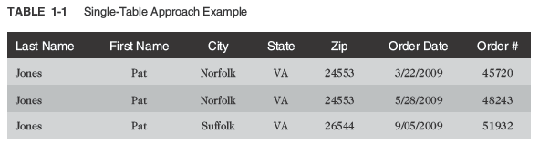
Database Normalization (continued)
Data redundancy – refers to having the same data in different places within a database
Data anomalies – refers to data inconsistencies
Oracle 11g: SQL

Slide 13
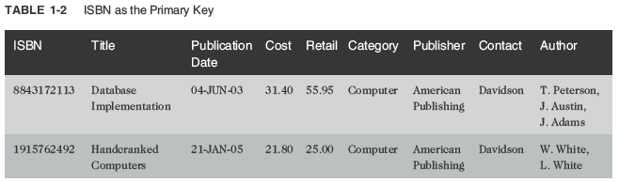
Unnormalized Data
Contains repeating groups in the Author column in the BOOKS table
Oracle 11g: SQL

Slide 14
First-Normal Form (1NF)
Primary key is identified
Repeating groups are eliminated
Oracle 11g: SQL

Slide 15
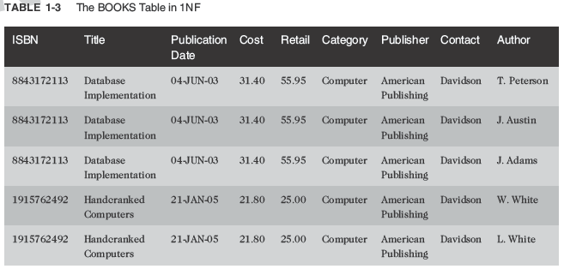
First-Normal Form (1NF) (continued)
ISBN and Author columns together create a composite primary key

Slide 16
Composite Primary Key
More than one column is required to uniquely identify a row
Can lead to partial dependency – a column is only dependent on a portion of the primary key
Oracle 11g: SQL

Slide 17
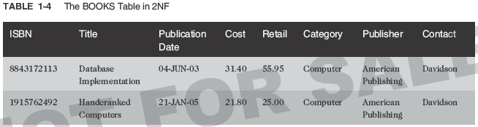
Second-Normal Form (2NF)
Partial dependency must be eliminated
  Break the composite primary key into two parts, each part representing a separate table
Oracle 11g: SQL

Slide 18
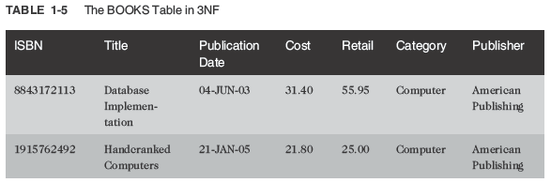
Third-Normal Form (3NF)
Publisher contact name has been removed
Oracle 11g: SQL

Slide 19
Summary of Normalization Steps
1NF: eliminate repeating groups, identify the primary key
2NF: table is in 1NF, and partial dependencies are eliminated
3NF: table is in 2NF, and transitive dependencies are eliminated
Oracle 11g: SQL

Slide 20
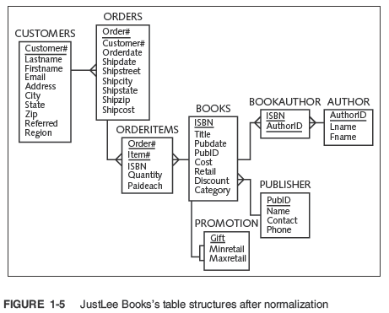
Oracle 11g: SQL

Slide 21
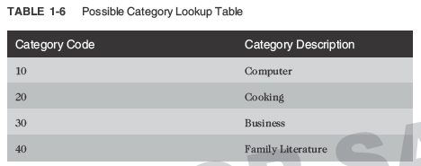
Lookup Table
Common reference for descriptive data tables referenced in a foreign key
Oracle 11g: SQL

Slide 22
4NF – Fourth Normal Form
With BCNF, no longer any anomalies from functional dependencies. Can still have anomalies from multi-valued dependencies
OFFERING
Course | Instructor | Textbook
Management | White Green Black | Drucker Peters
Finance | Gray | Jones Chang
Course | Instructor | Textbook
Management | White | Drucker
Management | White | Peters
Management | Green | Drucker
Management | Green | Peters
Management | Black | Drucker
Management | Black | Peters
Finance | Gray | Jones
Finance | Gray | Chang
Notes:
Each course has well-defined set of instructors (eg. 3 for Management)
Each course has well defined set of textbooks (eg. 2 for Finance)
For a given course, textbooks are independent of instructor
Anomaly
- add another textbook for Management requires inserting THREE rows (one per instructor)

Slide 23
4NF – Fourth Normal Form
Fracture into 2 independent relations
TEACHER
TEXTBOOK
Course | Instructor
Management | White
Management | Green
Management | Black
Finance | Gray
Course | Textbook
Management | Drucker
Management | Peters
Finance | Jones
Finance | Chang
Notes:
Watch out for anything that looks like a cross-product

Slide 24
Higher Normal Forms
5NF – Fifth Normal Form
  Deals with “loss-less joins”
DKNF – Domain Key Normal Form
  Ultimate that takes into account all possible dependencies and constraints
  What lookup tables actually are doing
… depends upon the key, the whole key, and nothing but the key, so help you Codd …
Notes:
Most problems with normalization occur because of compound keys.
This is why most data ‘purists’ want only a simple primary key field for any relation.

Slide 25
Denormalization
Normalization splits tables into smaller tables
  Need to be re-joined for most queries to retrieve a complete picture of the data
  The more tables in a database, the more joins are needed: overhead, system performance affected
Denormalization is the reverse process
  Deliberately reduces the normal form and increases data redundancy
  More storage could be required; anomalies and inconsistent data could exist
  Designer has to weigh this against performance to come up with a good design.

Slide 26
Denormalization
Often have to merge normalized relations that have arisen from separate ERD’s and user views to eliminate redundancy
aka View Integration
  EMPLOYEE1(Emp_ID, Name, Phone)
  EMPLOYEE2(Emp_ID, Name, JobCode, No_Years)
Notes:
Switchboard operator view vs. Personnel clerk view
EMPLOYEE(Emp_ID, Name, Phone, JobCode, No_Years)

Slide 27
Partitioning
Splitting logical records into separate physical groupings based on affinity of use
PRODUCT (Product_ID, Description, Drawing_Number, Weight,
Colour, Unit_Cost, Burden_Rate, Price, Product_Manager)
ENGR_PRODUCT (Product_ID, Description, Drawing_Number, Weight, Colour)
ACCT_PRODUCT (Product_ID, Unit_Cost, Burden_Rate)
MKTG_PRODUCT (Product_ID, Description, Price, Product_Manager)
CUSTOMER (Customer_ID, Cust_Name, Region, …)
A_CUSTOMER separate tables for Atlantic,
P_CUSTOMER Pacific, South Region
S_CUSTOMER
}
Notes:
Vertical – only certain COLUMNS
Horizontal – only certain ROWS
Note that Description is used in multiple places

Slide 28
Problems with Denormalization
Synonyms
Two attributes with different names but the same meaning
  eg. Employee_Nbr, Staff_ID
Alias
Allowable alternative name
  eg. Social_Insurance_Number, SIN

Slide 29
Problems with Denormalization
Homonyms
Two attributes with same name but having different meanings
eg. Terms may be too generic like ‘Invoice’
eg. Usage context is different like ‘Address’ on
STUDENT1 and STUDENT2
Notes:
Invoice
You invoice customers - money in
Suppliers invoice you - money out
Address
Local residence while on campus
Permanent home (out of town)

Slide 30
Problems with Denormalization
Transitive Dependencies
  Could be introduced between non-key attributes
  STUDENT1(Stud_ID, Major)
  STUDENT2(Stud_ID, Advisor)
Notes:
merges to be
STUDENT(Stud_ID, Major, Advisor)
but if each major has exactly one advisor
Major → Advisor !!!
replace with
STUDENT(Stud_ID, Major)
MAJOR_ADVISOR(Major, Advisor)

Slide 31
Problems with Denormalization
Supertype / Subtype Relationships
  May be hidden in generic terms
  PATIENT1(Patient_ID, Name, Address)
  PATIENT2(Patient_ID, Room_Nbr)
Notes:
All Patients have attributes from PATIENT1, but only In-Patients will have Room_Nbr (as well as Date Admitted, Date Discharged)
Out-Patients is waiting to be discovered!

